Slide 1
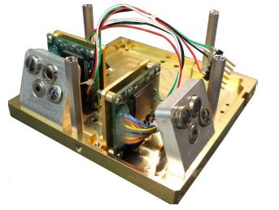
EHS Selection
Brand | Temp Range | Power Usage | Mass | Accuracy | Cost
MAI-SES | -40 to 80°C | 0.264 W | 33g | >7° | $12655 for 2
Many manufacturers have ceased production of Earth Horizon Sensors as they are expensive,
heavy, and have a high power consumption. MAI-SES currently produces one that should fit
our needs for attitude determination without moving parts.

Slide 2
How an EHS works
Determine area obscured
Calculate nadir angle from area
Resolve ambiguity with 2nd sensor
Determine position

Slide 3


Passive Attitude Control
Using a bar magnet to align with the Earth’s magnetic field
Will ensure the bottom of the CUBESAT will point nadir

Slide 4
Reaction Wheels Selection
Brand | Speed Range | Power Usage | Mass | Accuracy | Cost
Cubewheel Large | ±8000 RPM | 1.8 W (peak) | 162g | <5 RPM | $7352.45
Cubewheel Small | ±8000 RPM | <1 W (peak) | 47g | <5 RPM | $5973.86
Clyde Space | 6500 RPM | <28 W (peak) | 1.5 kg | ±1 RPM | $35000.00
A set of 3 reaction wheels allows for complete attitude determination and control,
one for each axis. They are relatively lightweight and use little power.

